Slide 1
Credit Card Default Risk Analysis
Monika Singh

Slide 2
Motivation
More than 80 percent of American adults had at least one credit card in 2020, according to the Federal Reserve.
The average American has 3.84 credit cards, according to the most recent data from Experian.
Credit card Default
Credit card default happens when a borrower does not make the required payments.

Slide 3
Motivation
This imposes a massive risk on credit card companies.
There needs to be a way to identify such customers beforehand and flag them.

Slide 4
Goal
To identify the features which we can predict whether a customer will default on their credit card payment or not.

Slide 5
Dataset
Data set: American Express https://www.kaggle.com/datasets/pradip11/amexpert-codelab-2021?select=train.csv
Observations: 45,528
Features: 19

Slide 6
Features
Categorical Features:
Gender
Owns car
Owns house
Occupation type
Numerical Features:
Age
Number of children
Net yearly income
Number of days employed
Total family members
Migrant worker
Yearly debt payments
Credit limit
Credit limit used(%)
Credit Score
Previous defaults
Default in last 6 months
Credit card default

Slide 7
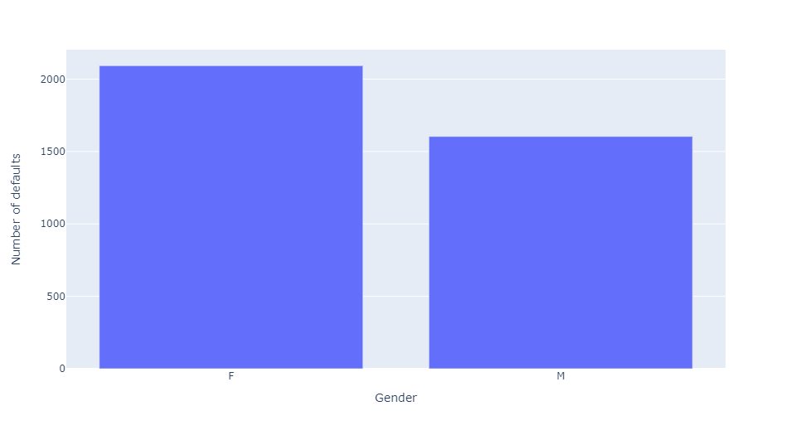
Gender

Slide 8
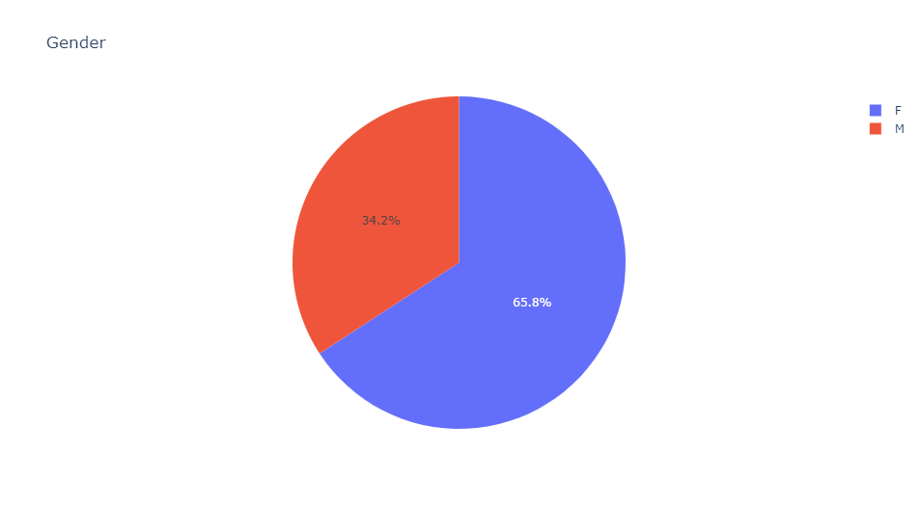
Gender

Slide 9
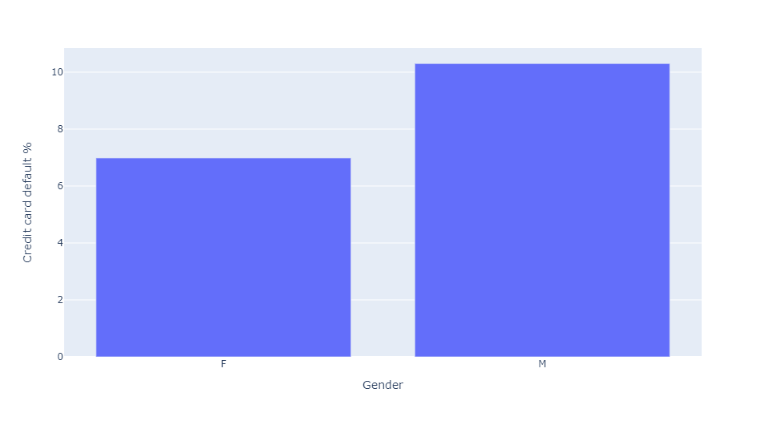
Gender

Slide 10
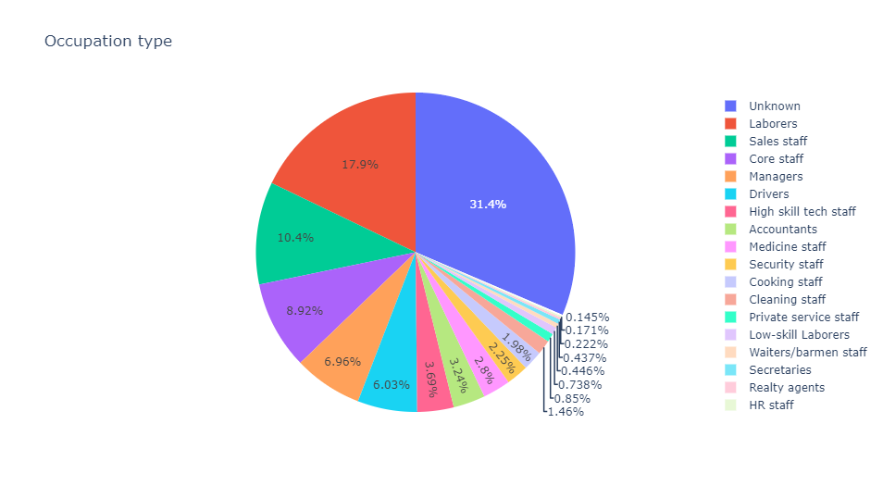
Employment Type

Slide 11
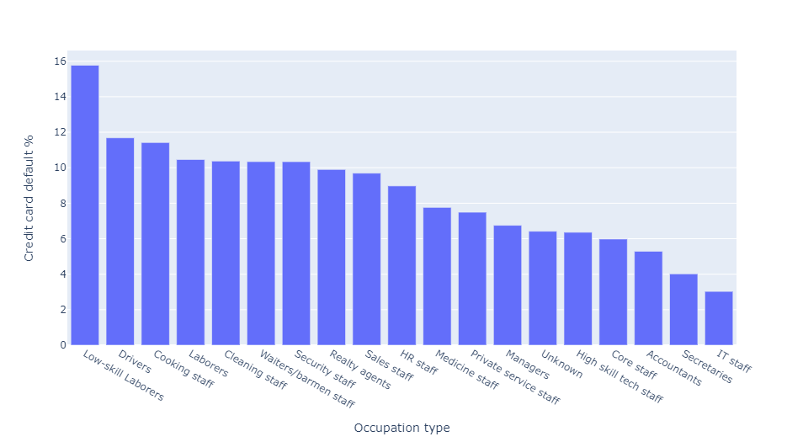
Employment Type

Slide 12
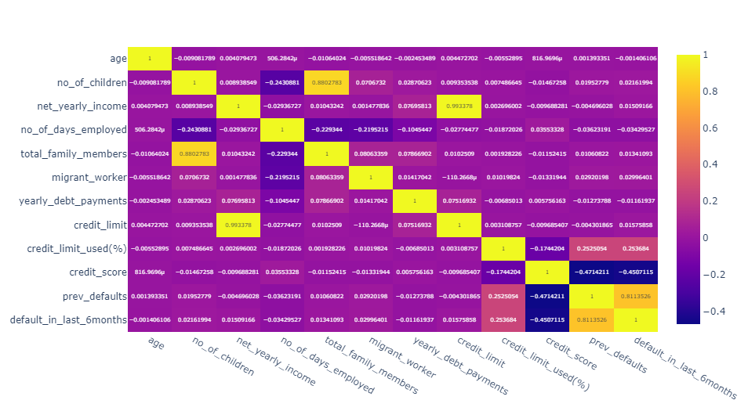
Independent features

Slide 13
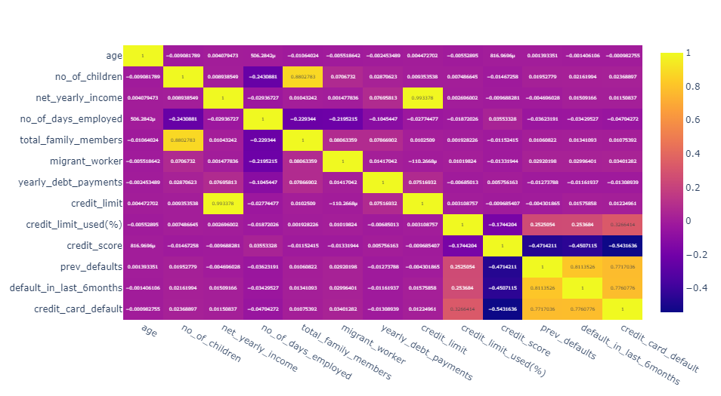
Correlated Features

Slide 14
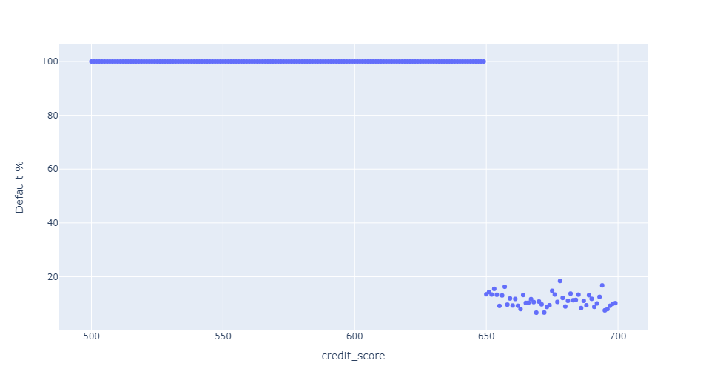
Credit Score

Slide 15
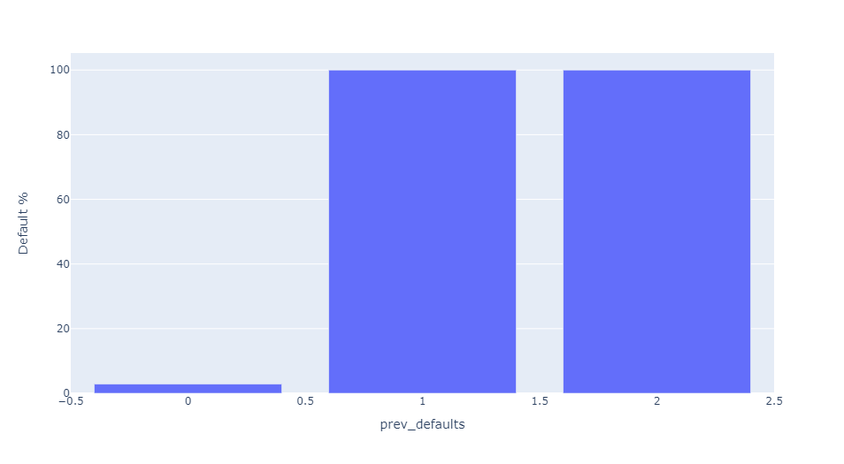
Previous Defaults

Slide 16
Multi Variable Analysis
Credit Card Limit Used
Low : 34% or less
Mid : More than 36% and less than equal 71 %
High : More than 71% and less than equal 99 %
Credit Score
Low : 731 or less
Mid : More than 731 and less than equal 840
High : More than 840 and less than equal949

Slide 17
Multi Variable Analysis
Previous-Default:
Low : 0
Mid : 1
High : 2 or more

Slide 18
category ID | credit limit % used | credit score | Number of previous defaults | Number of defaults | Number of people in category | % default
cl_cs_pd_000 | Low | Low | 0 | 0 | 4251 | 0
cl_cs_pd_010 | Low | Mid | 0 | 0 | 5756 | 0
cl_cs_pd_020 | Low | High | 0 | 0 | 5559 | 0
cl_cs_pd_100 | Mid | Low | 0 | 84 | 4106 | 2.045787
cl_cs_pd_101 | Mid | Low | 1 | 134 | 134 | 100
cl_cs_pd_102 | Mid | Low | 2 | 17 | 17 | 100
cl_cs_pd_110 | Mid | Mid | 0 | 0 | 5272 | 0
cl_cs_pd_120 | Mid | High | 0 | 0 | 5268 | 0
cl_cs_pd_200 | High | Low | 0 | 1145 | 4360 | 26.261468
cl_cs_pd_201 | High | Low | 1 | 2037 | 2037 | 100
cl_cs_pd_202 | High | Low | 2 | 279 | 279 | 100

Slide 19
category ID | credit limit % used | credit score | Number of previous defaults | Number of defaults | Number of people in category | % default
cl_cs_pd_000 | Low | Low | 0 | 0 | 4251 | 0
cl_cs_pd_010 | Low | Mid | 0 | 0 | 5756 | 0
cl_cs_pd_020 | Low | High | 0 | 0 | 5559 | 0
cl_cs_pd_100 | Mid | Low | 0 | 84 | 4106 | 2.045787
cl_cs_pd_101 | Mid | Low | 1 | 134 | 134 | 100
cl_cs_pd_102 | Mid | Low | 2 | 17 | 17 | 100
cl_cs_pd_110 | Mid | Mid | 0 | 0 | 5272 | 0
cl_cs_pd_120 | Mid | High | 0 | 0 | 5268 | 0
cl_cs_pd_200 | High | Low | 0 | 1145 | 4360 | 26.261468
cl_cs_pd_201 | High | Low | 1 | 2037 | 2037 | 100
cl_cs_pd_202 | High | Low | 2 | 279 | 279 | 100

Slide 20
category ID | credit limit % used | credit score | Number of previous defaults | Number of defaults | Number of people in category | % default
cl_cs_pd_000 | Low | Low | 0 | 0 | 4251 | 0
cl_cs_pd_010 | Low | Mid | 0 | 0 | 5756 | 0
cl_cs_pd_020 | Low | High | 0 | 0 | 5559 | 0
cl_cs_pd_100 | Mid | Low | 0 | 84 | 4106 | 2.045787
cl_cs_pd_101 | Mid | Low | 1 | 134 | 134 | 100
cl_cs_pd_102 | Mid | Low | 2 | 17 | 17 | 100
cl_cs_pd_110 | Mid | Mid | 0 | 0 | 5272 | 0
cl_cs_pd_120 | Mid | High | 0 | 0 | 5268 | 0
cl_cs_pd_200 | High | Low | 0 | 1145 | 4360 | 26.261468
cl_cs_pd_201 | High | Low | 1 | 2037 | 2037 | 100
cl_cs_pd_202 | High | Low | 2 | 279 | 279 | 100

Slide 21
category ID | credit limit % used | credit score | Number of previous defaults | Number of defaults | Number of people in category | % default
cl_cs_pd_000 | Low | Low | 0 | 0 | 4251 | 0
cl_cs_pd_010 | Low | Mid | 0 | 0 | 5756 | 0
cl_cs_pd_020 | Low | High | 0 | 0 | 5559 | 0
cl_cs_pd_100 | Mid | Low | 0 | 84 | 4106 | 2.045787
cl_cs_pd_101 | Mid | Low | 1 | 134 | 134 | 100
cl_cs_pd_102 | Mid | Low | 2 | 17 | 17 | 100
cl_cs_pd_110 | Mid | Mid | 0 | 0 | 5272 | 0
cl_cs_pd_120 | Mid | High | 0 | 0 | 5268 | 0
cl_cs_pd_200 | High | Low | 0 | 1145 | 4360 | 26.261468
cl_cs_pd_201 | High | Low | 1 | 2037 | 2037 | 100
cl_cs_pd_202 | High | Low | 2 | 279 | 279 | 100
cl_cs_pd_122 | Mid | High | 2 | 0 | 0 | -

